Slide 1

Readmission Insights
D601 – Task 2
Gaby Masak

Slide 2
Personal Introduction
Current: Student pursuing MS in Data Analytics at WGU
Data Science Volunteer at local clinic serving underrepresented and impoverished groups
Previous:
BS Computer Science, WGU
BS Petroleum Engineering, Penn State
BS Spanish, Penn State

Slide 3
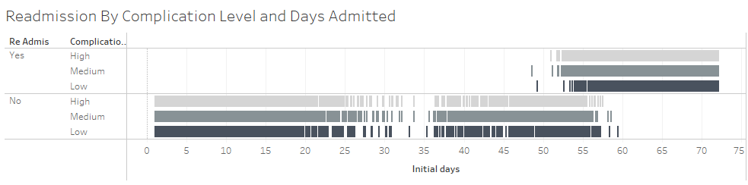
Impact of Initial Days Hospitalized and Complication Level on Readmission

Slide 4
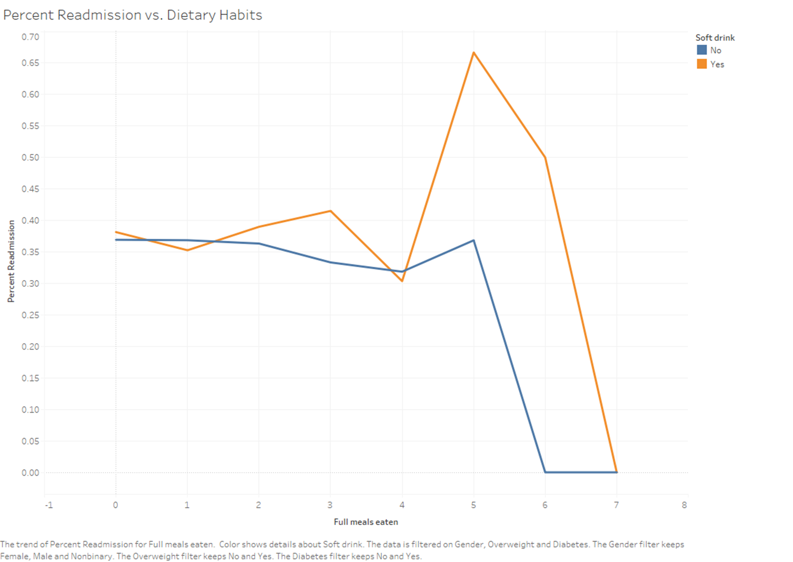
Dietary Habits Affect Readmission

Slide 5
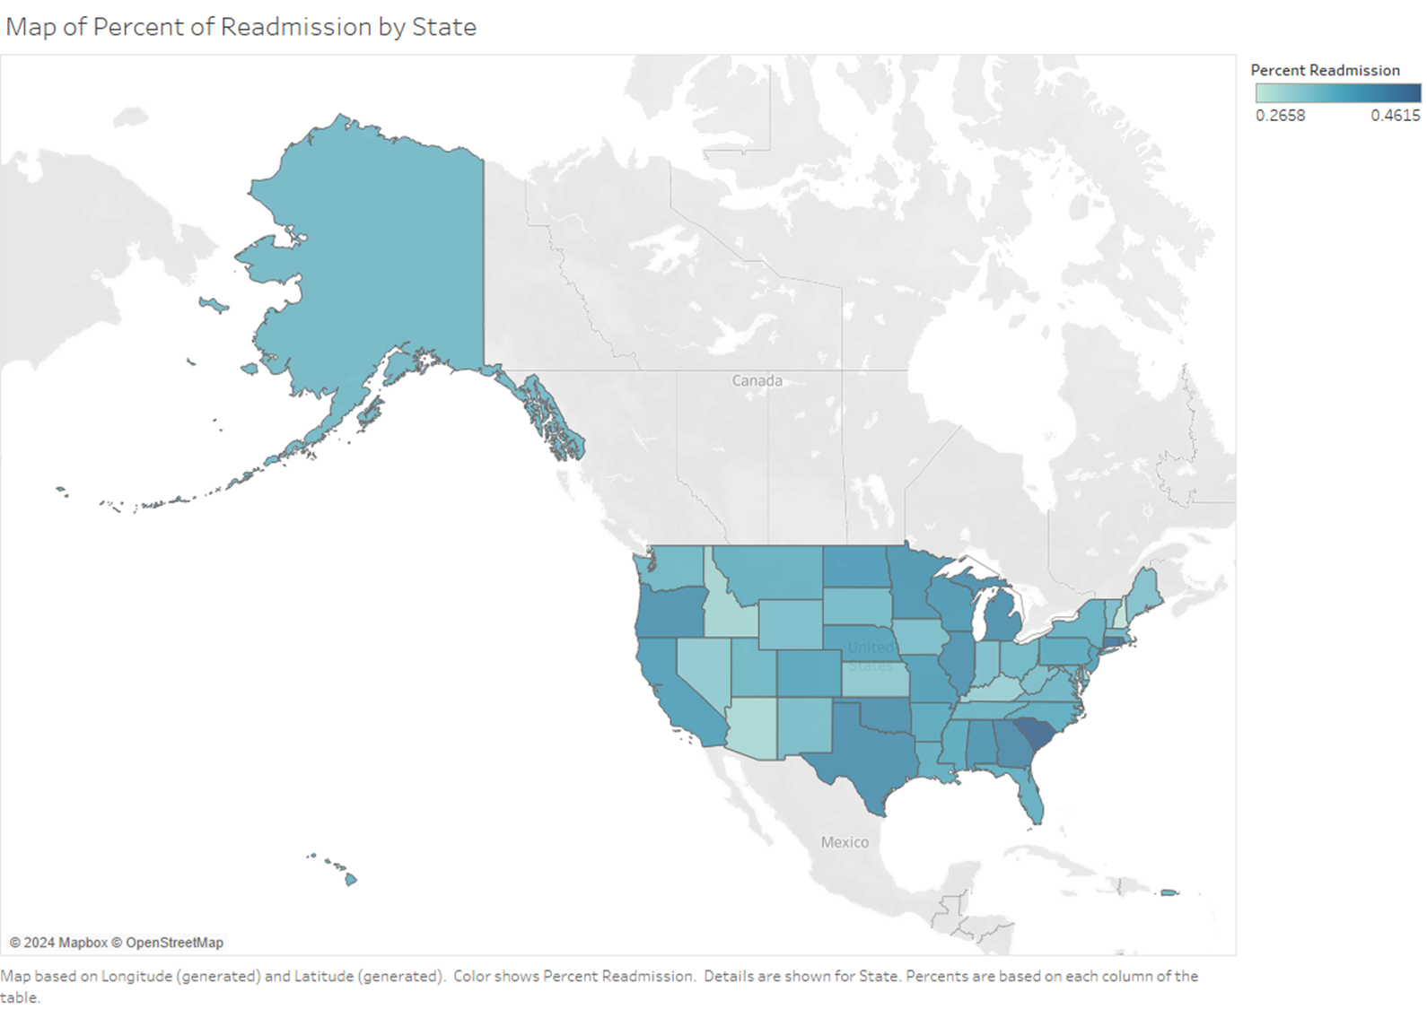
Percent of Readmission By State

Slide 6
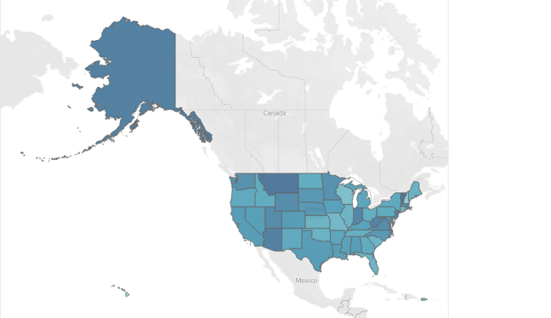
Average Number of Comorbidities By State
Percent of Readmission By State

Slide 7

Actionable Insights
Complication Level: largely not indicative of readmission or length of stay.
Length of Initial Hospitalization: Longer initial stays correlate with higher readmission rates across all complication levels.
Reducing the length of stay might help lower readmission rates.
Modify discharge metrics and practices for patients in the 52 – 57 day range of initial hospitalization.
Alternative, automated support for patients initially spending 55+ days hospitalized.
More focus on education on diet and other health habits while patient is hospitalized.
Promote 4 meals per day, restricting more if possible.

Slide 8
Discussion: Thoughts and Questions
What aspects of the data or our findings would you like to explore further?

